Slide 1

The Problem
In recent years, the demand for informal help in urban and semi-urban areas has increased, but there is no organized digital platform to connect task posters with local helpers. Traditionally, such tasks are posted on social media or managed informally, leading to inefficiencies and trust issues.
Currently, there is no structured way for users to easily find trusted local helpers for small, everyday tasks such as cleaning, shifting, errands, and tutoring. As a result, many people rely on unverified sources or word-of-mouth, which can be unreliable or unsafe.

Slide 2
The Solution
This project addresses those gaps by offering a digital platform that facilitates task posting, browsing, and verifying users through email and NID submission. By removing unnecessary features like payment processing from the Minimum Viable Product (MVP), the project aims for fast, achievable delivery while establishing a strong user foundation and trust system.
Simple
Secure
Trustworthy
Mobile-optimized interface for easy access
Identity verification through email and NID
Rating and review system for accountability

Slide 3
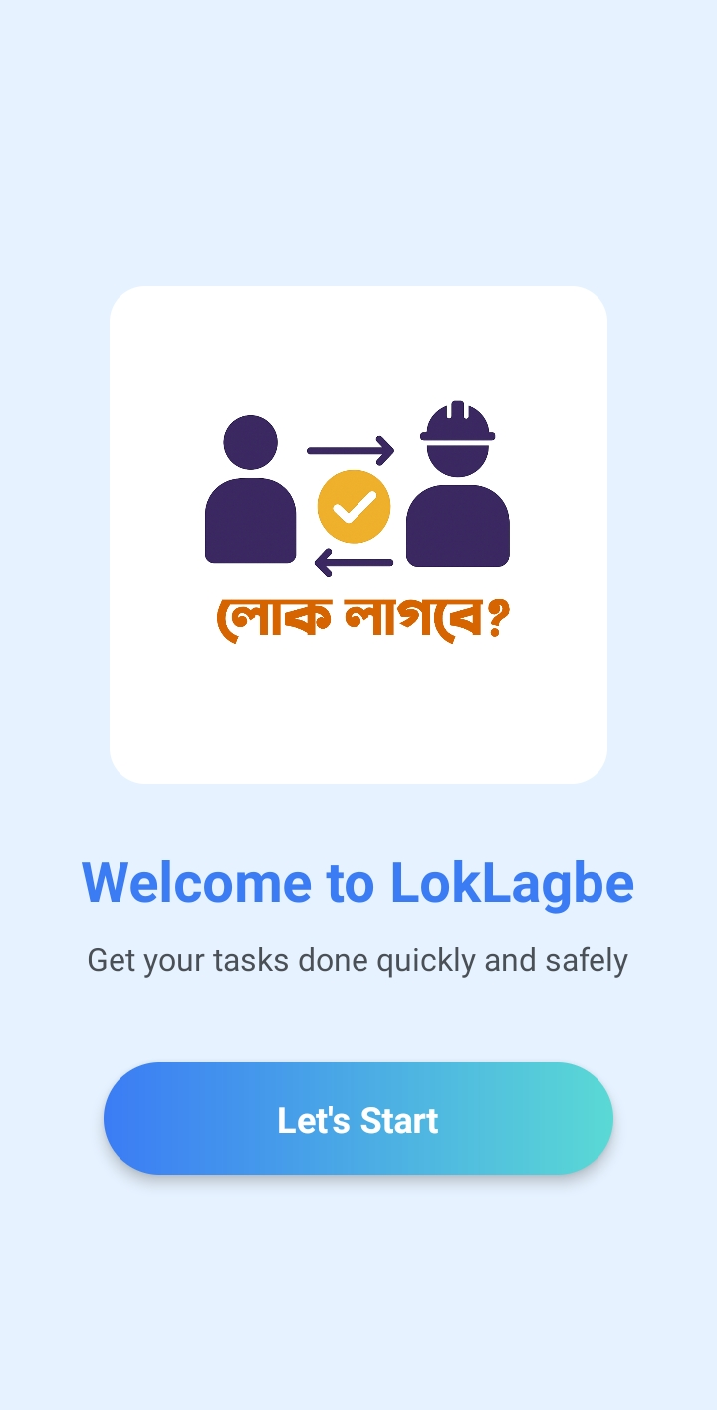
Lok Lagbe?
A mobile-first web application developed to manage the everyday task-posting and helping ecosystem in local communities.

Slide 4
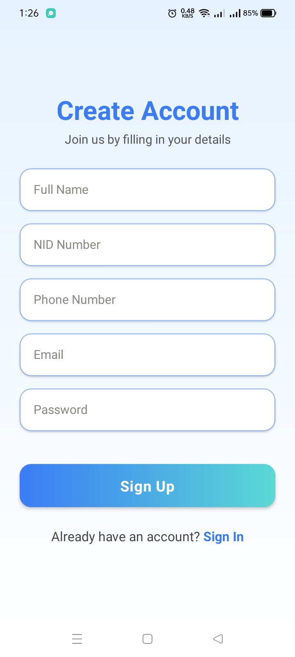
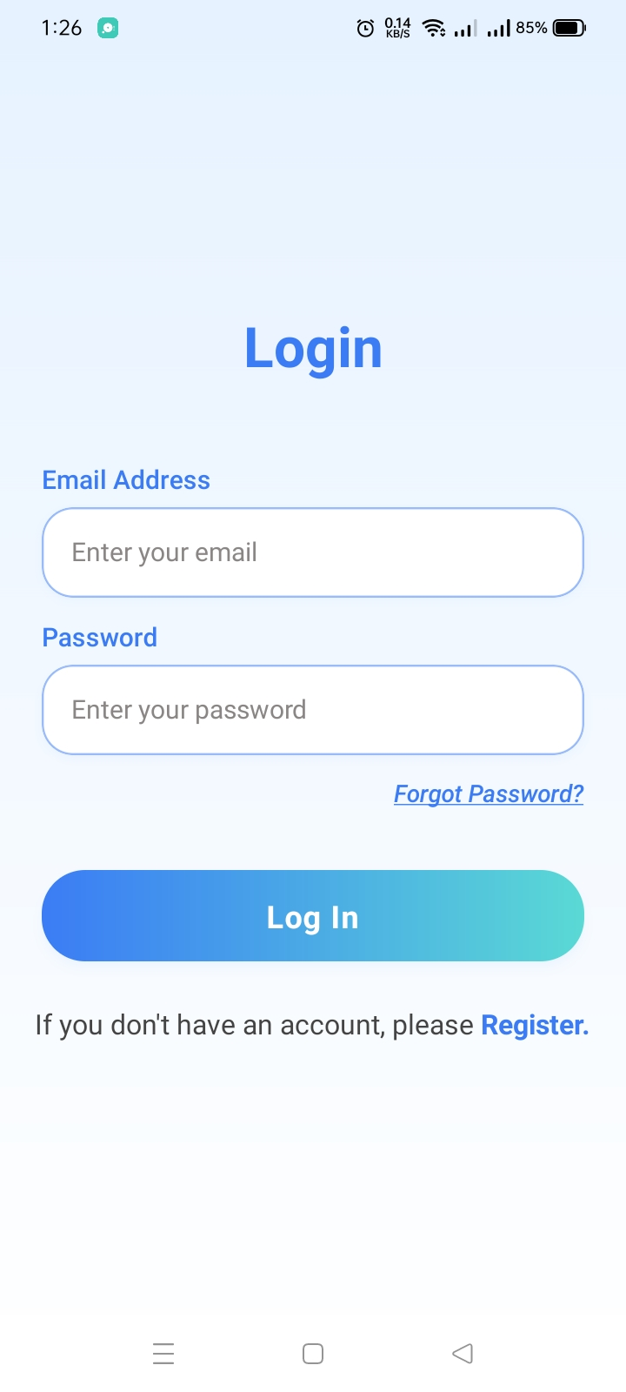
Core Features: User Registration
The "Lok Lagbe?" system is designed to provide a simple, secure, and mobile-optimized solution for connecting people who need help with those offering it. Users can register and verify their identity using email and NID submission, establishing a foundation of trust from the start.
This verification process ensures that both task posters and helpers are legitimate members of the community, reducing the risk of fraud or unsafe interactions.

Slide 5
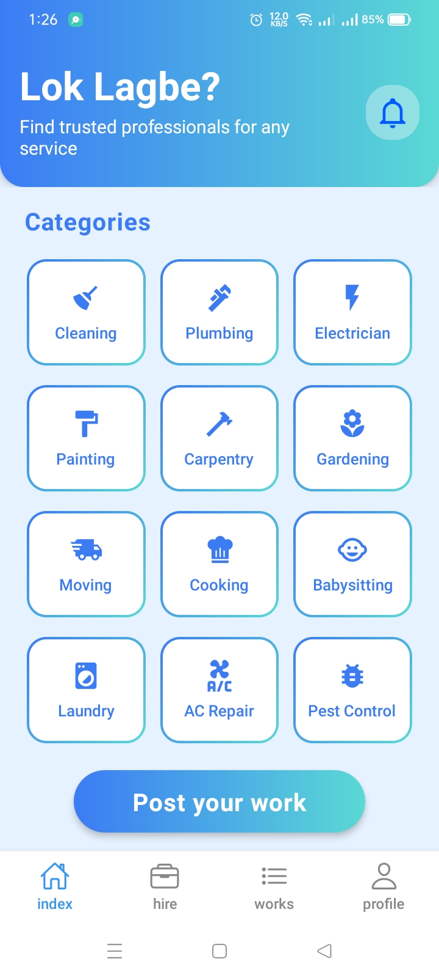
Core Features: Home Page
The "Lok Lagbe?" homepage serves as the central hub for users to easily navigate and explore available tasks. It features a clear, category-based organization, allowing both task posters and helpers to quickly find relevant opportunities.
Users can browse through various categories such as home maintenance, delivery, tutoring, or technical support. This intuitive layout ensures that finding or posting a task is streamlined, connecting users to the right community members efficiently.

Slide 6
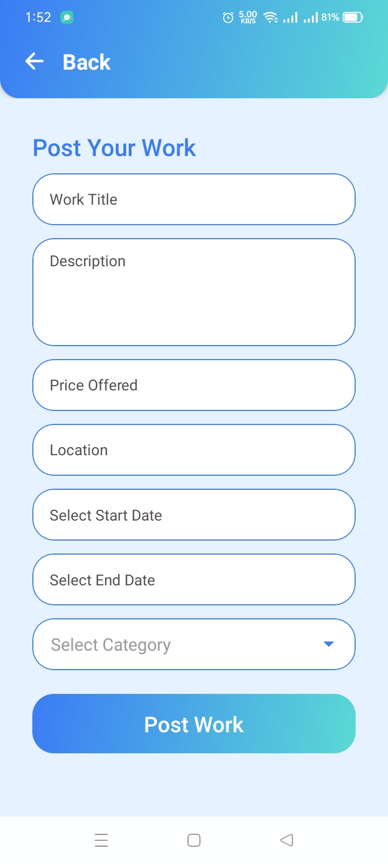
Core Features: Task Posting
Task Posting Form
Users can submit tasks by filling out a digital form. The form includes fields like task title, description, date, category, and location. Once submitted, it becomes available for browsing. Helpers can then review and accept tasks based on availability and interest.

Slide 7
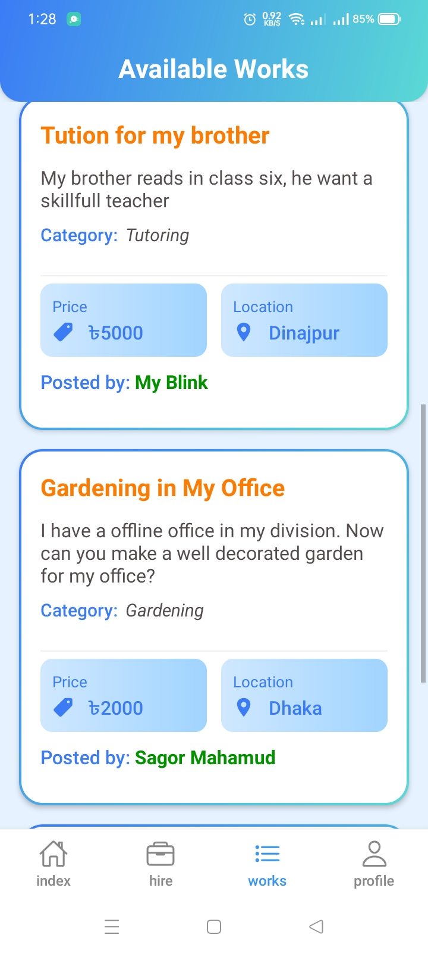
Core Features: Task Discovery
Users can browse available tasks based on location and category, making it easy to find opportunities that match their skills and availability. The platform allows users to track task status from posting to completion, ensuring transparency throughout the process.

Slide 8




Task Workflow Management
The task lifecycle follows a clearly defined sequence: Posted → Accepted → Pending → Completed. Admins ensure that task flows are valid and intervene in case of abuse. Since payments are excluded in the MVP, the workflow remains lightweight and focused on matching and communication.
Posted
Accepted
Pending
Completed

Slide 9
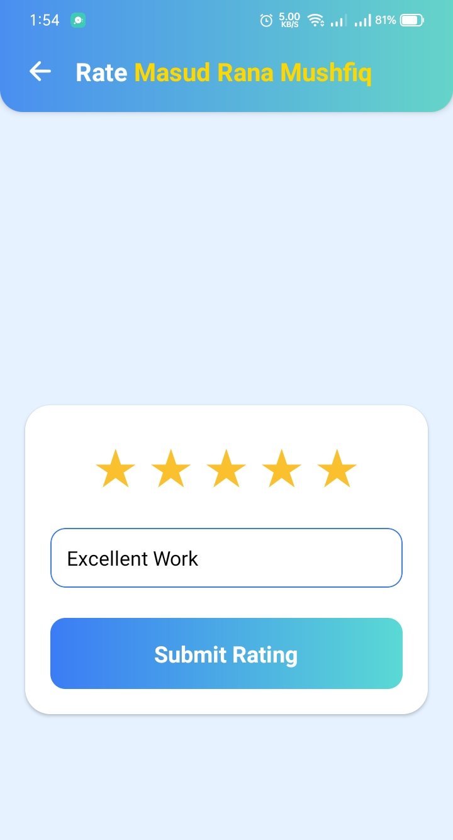
Core Feature: Rate and Review
Our integrated rating and review system allows users to provide feedback on completed tasks. Task posters can rate helpers, and helpers can rate task posters. This builds a robust reputation system, fostering trust and accountability within the community. High ratings encourage quality service, while transparent reviews help users make informed decisions.

Slide 10
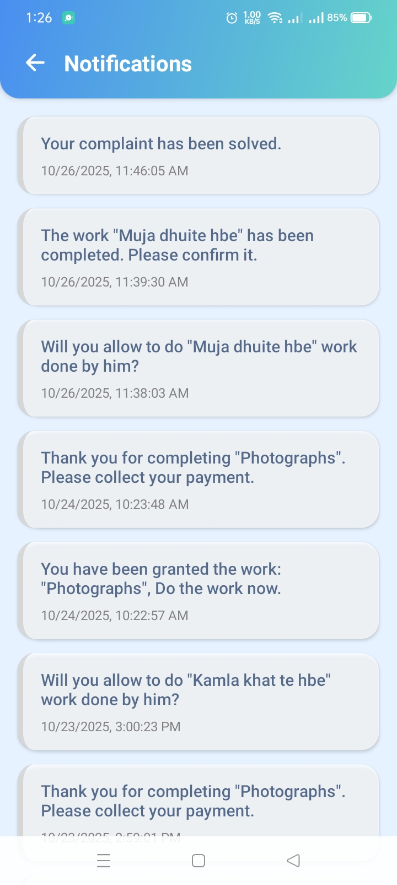
Core Features: Notification System
To ensure seamless communication and transparency, Lok Lagbe? includes a robust notification system. Users receive real-time updates on crucial task events, keeping them informed every step of the way.
Task Status Changes: Get alerts when a task you posted is accepted by a helper, or when a task you're helping with is marked as completed.
Important Updates: Stay informed about reports, disputes, or system messages from administrators.

Slide 11
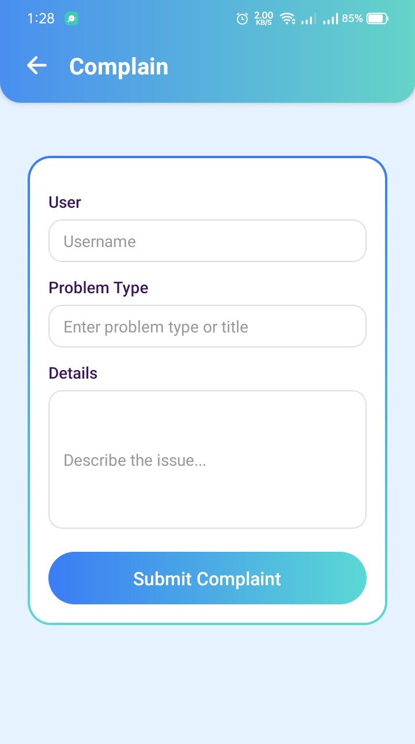
Core Features: Complain Mechanism
To ensure the safety and integrity of the "Lok Lagbe?" community, a robust complain mechanism is integrated into the platform. Users can easily report inappropriate behavior, fake profiles, or any disputes related to tasks directly through the application.
This feature allows for prompt action against malicious activities, reinforcing trust and accountability among users. It serves as a vital tool for community moderation, ensuring a secure and respectful environment for everyone.

Slide 12
Administrator Capabilities
Admins have special privileges and can view, edit, or delete user and task records. They review reports and take action such as blocking users. Admins also moderate content and manage trust and safety settings to maintain platform integrity.
View & Manage Records
Review Reports
Content Moderation
Access to all user and task information
Investigate flagged behavior and take action
Ensure platform safety and community standards

Slide 13
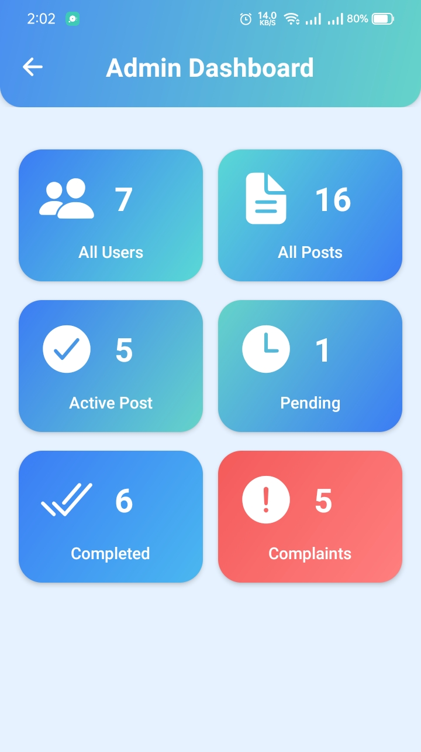
Task Workflow Management
Comprehensive Task Oversight
Administrators have a dedicated dashboard to monitor all active, pending, and completed tasks. This allows for proactive management, ensuring tasks progress smoothly and efficiently, from posting to resolution.
User and Complaint Resolution
Admins can review detailed task histories and user interactions. In cases of complaints or flagged behavior, they can investigate disputes, access relevant data, and implement necessary actions to maintain fair play and resolve issues promptly.

Slide 14
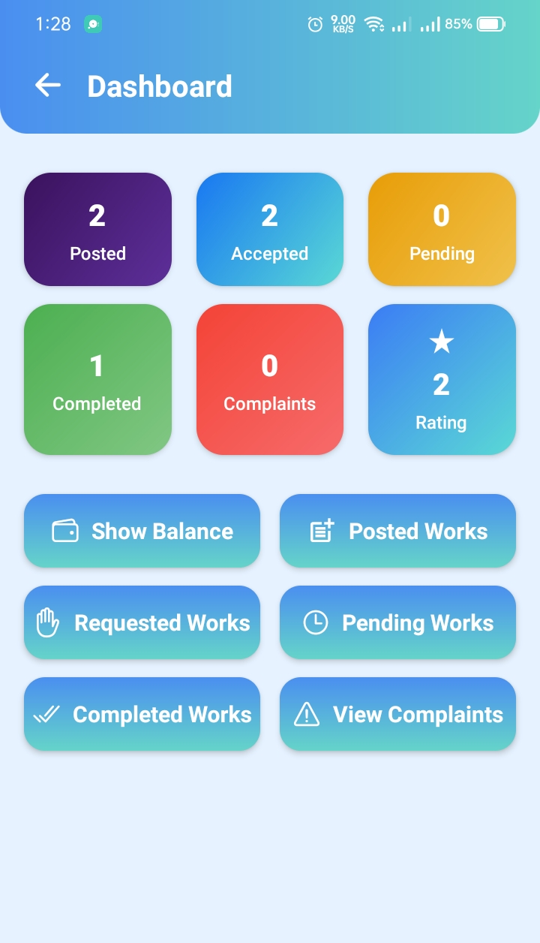
Core Features:
User Dashboard
Work History: A detailed record of all completed tasks, allowing users to track their past contributions and earnings.
Tasks In Progress: Real-time updates on active tasks, including those they've posted and those they are currently performing as a helper.
Wallet: A secure section to view available credits, earnings from completed tasks, and transaction history, ensuring financial transparency.

Slide 15
Why Lok Lagbe?
By digitizing and streamlining these interactions, "Lok Lagbe?" aims to reduce friction, improve trust, and enable safe collaboration in everyday work environments. The platform removes unnecessary features like payment processing from the Minimum Viable Product, allowing for fast, achievable delivery while establishing a strong user foundation and trust system that can grow with the community.
?

